Slide 1


BE Project Review Presentation On “Automated Video Transcript Summarizer .”
Presented By Project Coordinator
Agrawal Khushbu Prof . A. S. Gavade
Gajare Krushna
Pisal Pranav
Wagh Manasi
Guided By
Prof. A. A. Yadav

Slide 2
Outline
Introduction
Motivation
Problem Statement
Objectives
System Architecture
Literature Survey
Gap Analysis
Hardware and Software Requirements
Applications
Methodology
Result
Conclusion
References

Slide 3
Introduction
The “Automated Video Transcript Summarizer” project aims to simplify the process of gathering key insights from video content. By using advanced techniques, this project automatically summarizes video transcripts, helping users save time, quickly access important information, and gain valuable insights more efficiently.

Slide 4
Motivation
Information Overload: In today's digital landscape, the vast amount of video content overwhelms users, making it challenging to extract relevant information efficiently.
Time Constraints: Manual video content consumption requires substantial time, which clashes with busy schedules and the need for quick information retrieval.
Inefficient Manual Extraction: Traditional methods of watching and manually extracting information from videos are labor-intensive and fail to cater to the need for swift insights.
Enhanced Productivity: By automating the summarization process, users can optimize their time, focusing on analyzing insights rather than going through entire videos.
Practical Application: The system provides a practical solution to the problem of information overload, aligning technological advancements with tangible benefits for users.

Slide 5
Problem Statement
Designing and developing Automated Video Transcript Summarizer to identify crucial information and patterns without watching the entire video using NLP .

Slide 6
Objectives
To Implement advanced Natural Language Processing (NLP) techniques to automatically generate concise summaries from video transcripts.
To Integrate mechanisms to assess the relevance and significance of content within video transcripts.
To Incorporate automated translation capabilities to facilitate summarization of video transcripts in different languages.
To Design an intuitive and user-friendly interface that allows easy input of videos and retrieval of summarized content.

Slide 7
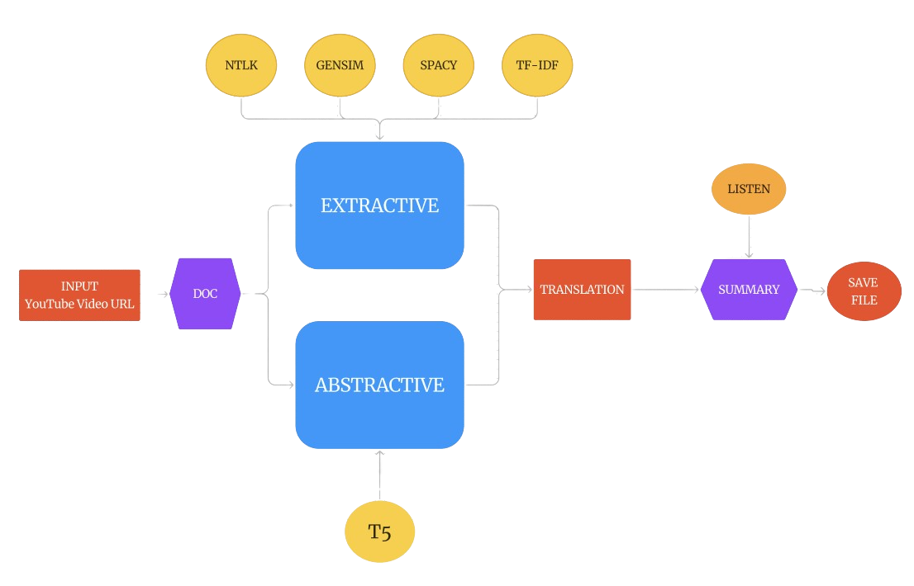
System Architecture
Fig . 1 System Architecture

Slide 8
Literature Survey
Paper 1- “Youtube Transcript Summarizer Using Flask and NLP” Journal Of Positive School Psychology.
From [1], Author employed a Flask-based backend server powers a YouTube transcript summarization system with user-friendly features like translation, speech synthesis, downloads, and email sharing. It retrieves YouTube video subtitles, uses a default CNN model for summarization, and leverages NLP techniques. This practical project aligns with NLP and text summarization research, enhancing content consumption efficiency and sharing.

Slide 9
Paper 2- “AI-based video Summarization Using FFmpeg and NLP” IJISRT
From [2], the author conducted a comprehensive research review on video summarization techniques. This survey covered both supervised and unsupervised methods, encompassing neural networks, attention mechanisms, and SVMs for video segmentation and summarization. FFmpeg emerged as a versatile tool for video processing, while Natural Language Processing (NLP) techniques proved crucial for audio transcript analysis. AssemblyAI's ASR and NLP services were recognized for their role in precise transcription. The study concluded with an ablation study highlighting the importance of combining FFmpeg, NLP, and video segmentation for effective video summarization

Slide 10
Paper 3- “Automated Video Program Summarization Using Speech Transcripts” IEEE TRANSACTIONS ON MULTIMEDIA
In [10], the author presents a video summarization method utilizing automatic speech recognition transcripts. Segments are created based on pauses, with scores derived from word and bigram frequencies. High-score-to-duration ratio segments are chosen for generating informative summaries that maximize coverage. A user study confirms the superiority of the proposed algorithm over others. The paper also examines diverse video summarization techniques, encompassing playback speed, frame clustering, domain knowledge, and closed-captions approaches. It discusses statistical and natural language processing-based methods for summarization.

Slide 11
Paper 4- “YouTube Transcript Summarizer” International Journal of Science and Research (IJSR)
From [7] author, in the research survey reveals several key areas for future development in YouTube transcript summarizers. These include enhancing natural language processing techniques for improved text analysis, advancing summarization algorithms by incorporating contextual data, extending multilingual support, developing personalized summarization approaches, and integrating these tools with various platforms for more tailored user experiences. The landscape of YouTube transcript summarizers offers diverse opportunities for refinement and expansion, promising a dynamic and extensive scope for future research and innovation.

Slide 12
Paper 5- “ Video Summarization using NLP” International Research Journal of Engineering and Technology (IRJET)
From [5], the author presents a video summarization system using NLP-based Latent Semantic Analysis (LSA) for YouTube content. Unlike complex alternatives, this system relies on YouTube's transcript API and Pytube for efficient subtitle extraction and video retrieval. LSA identifies and ranks key sentences for summarization, which are then adjusted to meet user-set time constraints. The final video summary is generated using the MoviePy library. This innovative approach addresses the rising demand for streamlined video content management in the era of online video consumption.

Slide 13
Paper6-“SURVEY PAPER ON YOUTUBE TRANSCRIPT SUMMARIZER” IRJMETS
From [3] author, it is evident that text summarization of YouTube videos benefits from NLP libraries like SpaCy and gensim. PyTube and Hugging Face's transformers are employed for real-time audio extraction and transcript generation, while cosine similarity enhances text summarization. The proposed chrome extension offers users an efficient means to access video summaries and identify objectionable content, improving their viewing experience.

Slide 14
Paper 7- “Youtube Transcript Summarizer” International Journal of Research in Engineering and Science (IJRES)
In [4], the author emphasizes leveraging spoken text and context in video summarization, particularly for speeches. They propose an NLP-based model with API integration for YouTube transcript summarization, addressing coherence challenges. NLP's role in enhancing computer understanding of human language and applications in customer service is highlighted. The project involves transcript retrieval, HuggingFace transformers for summarization, and Chrome extension development. Future directions include multi-lingual support and improved evaluation metrics.

Slide 15
Paper 8- “Video Transcription and Summarization using NLP” - AECE
In [9], the author emphasizes leveraging spoken text and context in video summarization, particularly for speeches. Author has used MoviePy library for transcript summarization and also used the google Transcribe for the purpose of transcript generation. They have used text rank algorithm in this process. Also they have provided the average time of video and generated transcript for particular video representing the length of generated summary for short and long videos.

Slide 16
Paper 9- “Attentive and Adversarial Learning for Video Summarization” IEEE Winter Conference on Applications of Computer Vision.
In [8], the author proposed an adversarial training framework for semi-supervised video summarization. Their approach utilizes an attention-based pointer network (Ptr-Net) as the generator, effectively addressing the issue of inconsistent lengths between training and test data. The discriminator, a 3D CNN classifier, determines the quality of summarization fragments. This framework operates as a generative adversarial network (GAN) and demonstrates state-of-the-art performance on benchmark datasets. Notably, the method leverages unpaired summarization fragments from the web, eliminating the need for additional original-versus-summarized video pairs.

Slide 17
Paper 10 - “Survey on Abstractive Transcript Summarization of YouTube Videos” IJARSCT
From [6], the author introduces extractive and abstractive methods for automatic text summarization. Extractive focuses on key sentences, while abstractive creates new ones. Techniques like tree-based, template-based, rule-based, and graph-based methods are used for extractive, and abstractive methods use semantic or graph-based models like PEGASUS. The text provides a comprehensive overview of these summarization strategies.

Slide 18
Paper 11 - “YOUTUBE TRANSCRIPT SUMMARIZER”, International Journal of Creative Research Thoughts.
In [11], the author focuses on building a chrome extension that is a small and easy to use tool for users who watch YouTube videos on browser. There is no need to change the tab because summary of transcript can be generated in place with popup window. Abstractive text summarization is used for transcript summarization that improves the quality of the summary generated.

Slide 19
Paper 12 - “YOUTUBE TRANSCRIPT SUMMARIZER”, INTERNATIONAL JOURNAL OF PROGRESSIVE RESEARCH IN ENGINEERING MANAGEMENT AND SCIENCE (IJPREMS)
In [12], the author presents a video transcript summarization tool impowered by Natural Language Processing techniques. Author has used the HuggingFace Library for the text summarization process that focuses on the Abstractive summarization model. The similarity of human on generating summary like using different words and generating new sentences from existing sentences matches with the working of Abstractive summarization model hence it works well with NLP algorithms.

Slide 20
Gap Analysis
Paper No | Ref. No | Name | Technique/Algorithm | Technology | Support for YT videos | Support for Non-YT videos | Accuracy Measures | Keyword Finding | Multi-Language Translate
1 | [1] | JPSP | NLP | Flask, NLP | ✓ | ✘ | ✘ | ✘ | ✘
2 | [2] | VSFN | LSTM, TVSum | AssemblyAI, NLP | ✓ | ✘ | ✓ | ✘ | ✘
3 | [10] | AVPSST | fuzzy -clustering algorithm | ASR | ✘ | ✘ | ✓ | ✘ | ✘
4 | [7] | IJSR | hugging face transformer | NLP, ML,DL | ✓ | ✘ | ✘ | ✘ | ✘

Slide 21
Paper No | Ref. No | Name | Technique/Algorithm | Technology | Support for YT videos | Support for Non-YT videos | Accuracy Measures | Keyword Finding | Multi-Language Translate
5 | [5] | IRJET | LSA | NLP, ML | ✓ | ✘ | ✘ | ✘ | ✘
6 | [3] | IRJMETS | PyTube, HuggingSound | NLP, Flask, REST API | ✓ | ✘ | ✘ | ✘ | ✘
7 | [4] | IJRES | HuggingFace transformers | NLP, Flask | ✓ | ✘ | ✘ | ✘ | ✘
8 | [9] | VTSN | Extractive text summarization | NLP, MoviePy | ✓ | ✘ | ✓ | ✘ | ✘

Slide 22
Paper No | Ref. No | Name | Technique/Algorithm | Technology | Support for YT videos | Support for Non-YT videos | Accuracy Measures | Keyword Finding | Multi-Language Translate
9 | [8] | AALVS | RNNs, LSTM | CNN, GAN | ✘ | ✓ | ✓ | ✘ | ✘
10 | [6] | IJARSCT | Extractive & Abtractive Summerization | NLP, REST API | ✓ | ✘ | ✘ | ✘ | ✘
11 | [11] | IJCRT | HuggingFace Transformers | Flask | ✓ | ✘ | ✘ | ✘ | ✘
12 | [12] | IJPREMS | Abstarctive Summarization | Flask | ✓ | ✘ | ✘ | ✘ | ✘

Slide 23
Software and Hardware Requirement
Software Requirements :-
Operating System: windows/linux/mac.
Programming Languages: HTML, CSS, JavaScript , Python.
Text Summarization Libraries: NLTK , Spacy
Speech-to-Text (ASR) Service: google speech – to – text.

Slide 24
Hardware Requirements :-
Desktop/Laptop Computers
CPU: A modern dual-core processor or higher.
RAM: At least 4GB to 8GB of RAM for smooth browsing and interactions.
Storage: A standard hard drive or SSD with enough storage space for downloaded content.
Internet Connectivity : A stable and reasonably fast internet connection (e.g., broadband or mobile data) to interact with your web application without interruptions.

Slide 25
Applications
Time Efficiency: Enhances time efficiency by swiftly providing valuable insights from videos, catering to modern individuals' time constraints.
Digital Inclusion: Fosters digital inclusion by enhancing video content accessibility for diverse levels of digital literacy.
Content Optimization: Enables content creators and educators to optimize video content, emphasizing essential information for impactful communication
Efficient Content Creation: Facilitates efficient content creation by helping creators review and refine videos for effective communication within shorter time frames.

Slide 26
Methodology
Input the URL / Video from user.
Using a Python API, find the transcripts and subtitles for a particular youtube video ID.
If transcript is available then perform text summarization on obtained transcript using
-> Any one Transformation techniques
4. Summarize the converted text.
5. We can translate summarized text in multiple languages like hindi , marathi (Future work)
6. If required save the summarized text.

Slide 27
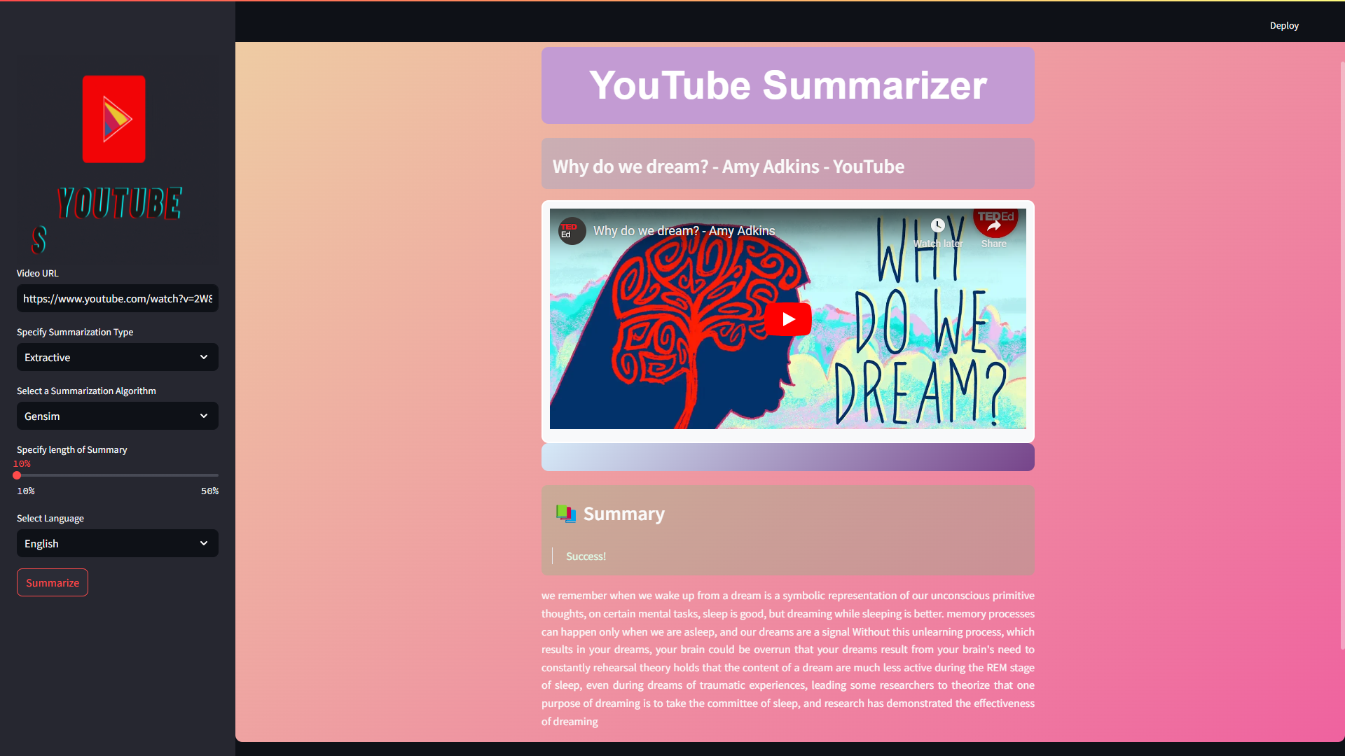
Result
Fig.2 Result 1

Slide 28
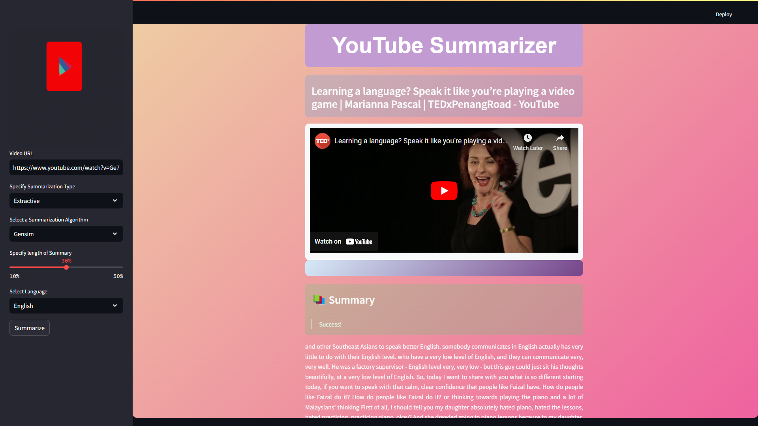
Result
Fig .3 Result 2

Slide 29
Conclusion
“Automated Video Transcript Summarizer” project helps tackle the problem of overwhelming video content by using Natural Language Processing (NLP) to automatically summarize information. This makes it easier for people to find the important points quickly and make decisions faster. By saving time and making content more accessible, the project supports better content creation and highlights the practical benefits of technology in our digital world.

Slide 30
References
P. Vijaya Kumari*, M. Chenna Keshava , C. Narendra , P. Akanksha , K. Sravani “ Youtube Transcript Summarizer Using Flask And Nlp “ , Journal of Positive School Psychology Issue-2022, Vol. 6, No. 8.
Hansaraj Wankhede, R Bharathi Kumar, Sushant Kawade, Ashish Ramtekkar, Rachana Chawke. “AI-based Video Summarization using FFmpeg and NLP”, International Journal of Innovative Science and Research Technology Issue- 4, April – 2023
Cuneyt M. Taskiran, Member, IEEE, Zygmunt Pizlo, Arnon Amir, Senior Member, IEEE, Dulce Ponceleon, Member, IEEE, and Edward J. Delp, Fellow, IEEE “Automated Video Program Summarization Using Speech Transcripts”, IEEE TRANSACTIONS ON MULTIMEDIA Issue-4, AUGUST 2006
Sarthak Jain , Jahnavi Jain , Gurminder Kaur , Dr. Yatu Rani,”International Journal of Science and Research (IJSR)” , Issue -2, February 2023
Sanjana R, Sai Gagana V, Vedhavathi K R, Kiran K N ,” Video Summarization using NLP ”, International Research Journal of Engineering and Technology (IRJET) Issue: 08 | Aug 2021

Slide 31
Eesha Inamdar, Varada Kalaskar, Vaidehi Zade,” SURVEY PAPER ON YOUTUBE TRANSCRIPT SUMMARIZER”, International Research Journal of Modernization in Engineering Technology and Science Issue:04/April-2023
Siddhartha , Prashu Pandey , Ansh Saxena GUIDE- Anupam kumar sharma, “Youtube Transcript Summarizer”, International Journal of Research in Engineering and Science (IJRES) Issue 5 ǁ May 2023
Pradeep Choudhary, Sowmya P. Munukutla, Rajesh K. S., Alok S. Shukla,” REAL TIME VIDEO SUMMARIZATION ON MOBILE PLATFORM”, Samsung Research and Development Institute India Issue-14 July 2017
Tsu-Jui Fu ,Shao-Heng Tai , Hwann-Tzong Chen National Tsing Hua University,” Attentive and Adversarial Learning for Video Summarization”, IEEE Winter Conference on Applications of Computer Vision Issue-11 .2019.

Slide 32
10. S. Tharun , R. Kranthi Kumar , P. Sai Sravanth, G. Srujan Reddy , B. Akshay,” Survey on Abstractive Transcript Summarization of YouTube Videos”, International Journal of Advanced Research in Science, Communication and Technology (IJARSCT) Issue-2, April 2022
11. Gousiya Begum, N. Musrat Sultana, Dharma Ashritha, “YOUTUBE TRANSCRIPT SUMMARIZER”, International Journal of Creative Research Thoughts. Volume 10 Issue 6 June 2022.
12. Tryphena Brighty, Pooja V, Jaya Varsini V, Vishnu Priya N, “YOUTUBE TRANSCRIPT SUMMARIZER”, INTERNATIONAL JOURNAL OF PROGRESSIVE RESEARCH IN ENGINEERING MANAGEMENT AND SCIENCE (IJPREMS), Vol. 03, Issue 05, May 2023.
13. Prof. S. H. Chaflekar, Achal Bahadure, Hosanna Bramhapurikar, Ruchika Satpute, Rutuja Jumde, Sakshi A. Bakhare, Shivani Bhirange, “YouTube Transcript Summarizer using Natural Language Processing”, International Journal of Advanced Research in Science, Communication and Technology (IJARSCT), Volume 2, Issue 1, April 2022.
14. Pradeepika Verma and Anshul Verma, “A Review on Text Summarization Techniques”, Journal of Scientific Research, Volume 64, Issue 1, 2020.

Slide 33
Thank You!!

